Slide 1


EnD-to-end Self-Driving Simulation
Chenhao fang
Hao Jiang
Kou Wang

Slide 2
Table of Contents
Introduction
Model Design
Training and Results
Conclusions

Slide 3

Introduction

Slide 4
Autonomous driving technology
Autonomous driving technology allows vehicles to self-drive
Background: a lot of people die in traffic accidents, and traffics are getting worse due to the increasement of the vehicles in the world
Offers a solution to traffic problem
Core technology: deep learning

Slide 5
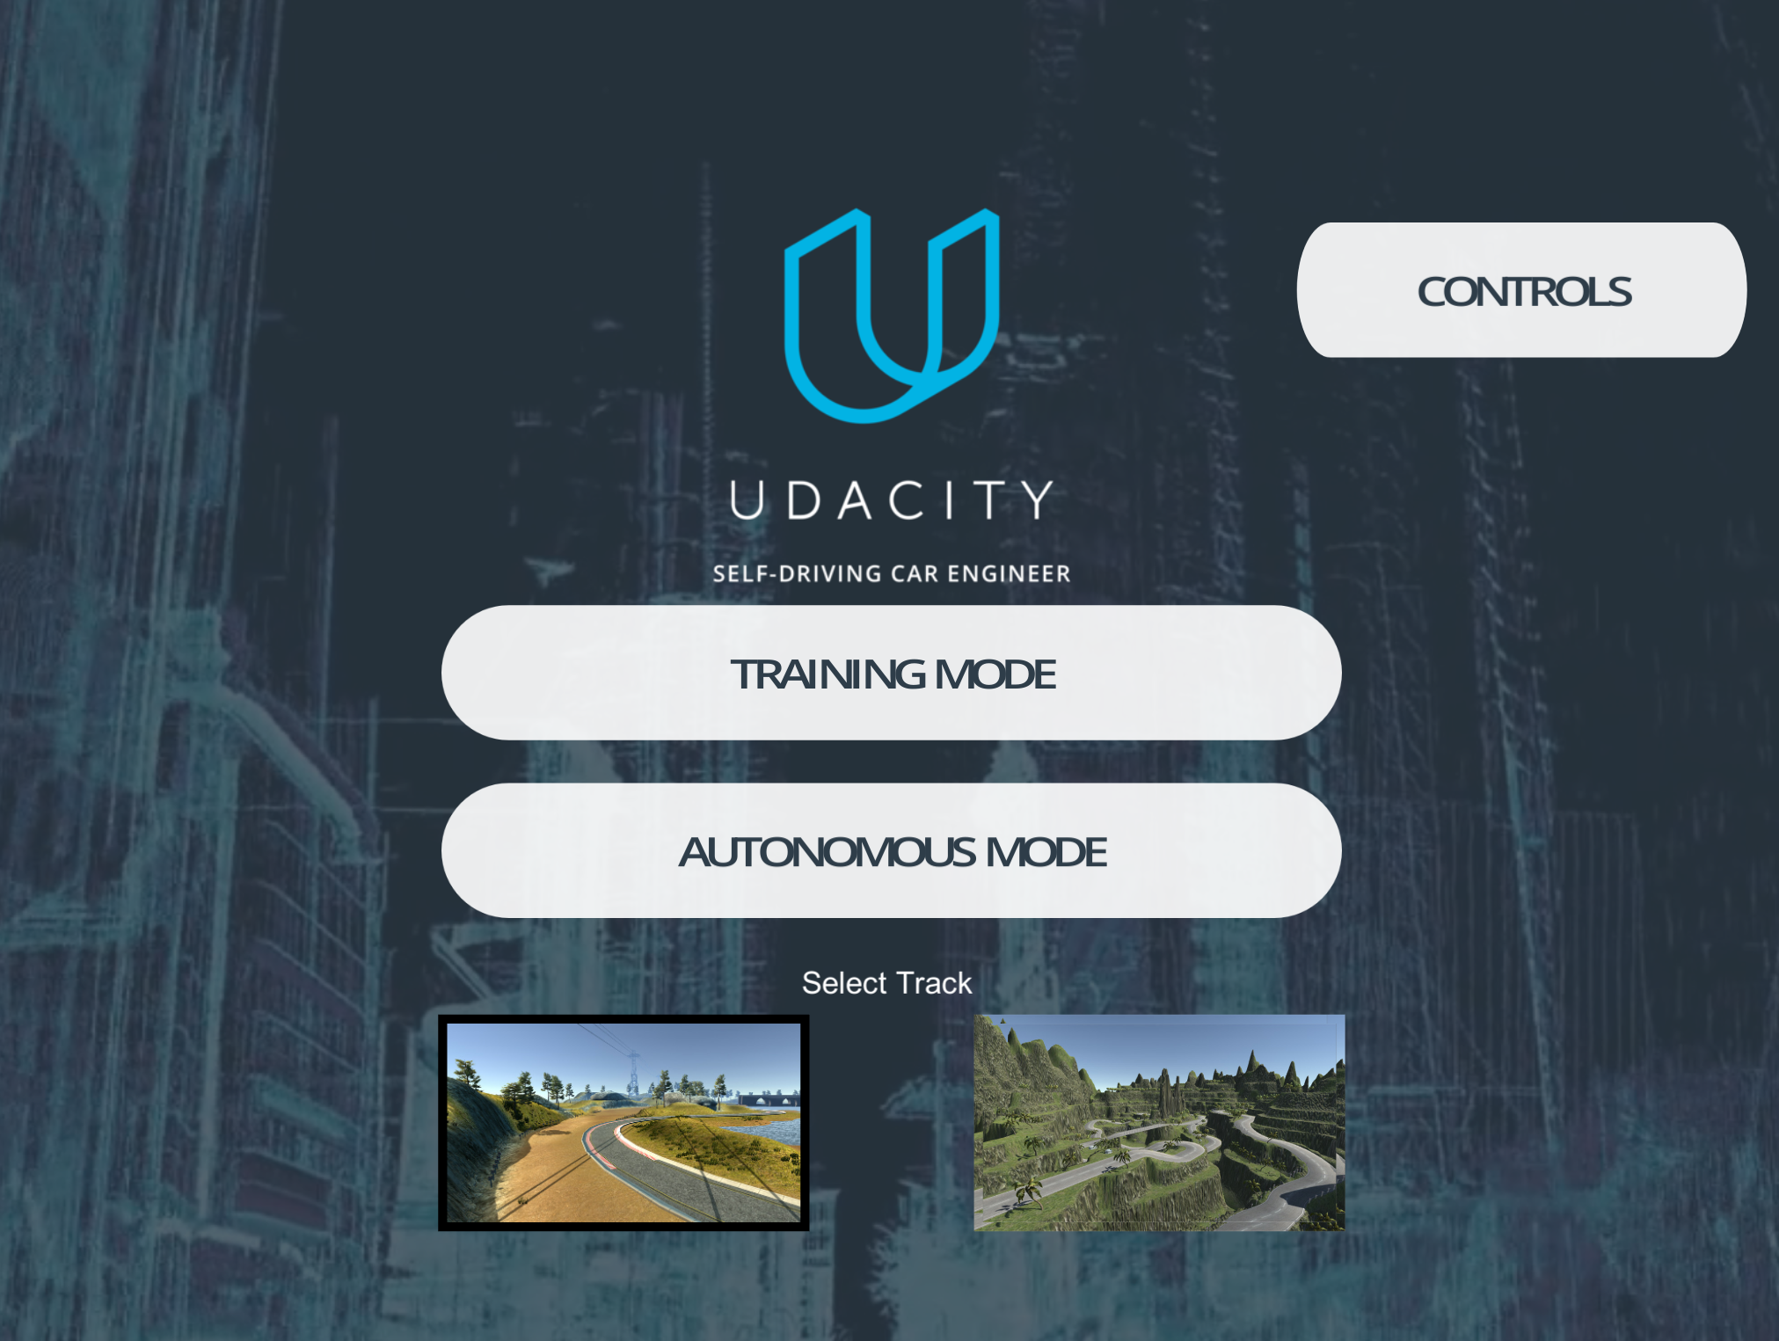
SELF-DRIVING CAR (SDC) IN SIMULATOR
We implemented a self-driving car in simulator
Udacity self-driving Car Engineer
Mannual mode & Autonomous mode
In the end of the project, our self-driving car (SDC) is able to drive autonomously in the designed track, which contains different road and background conditions

Slide 6
Input of self-driving car
In the simulator, the car is able to collect image data from three different cameras: left, middle, and right
Images are gathered and augmented, transformed into a different to achieve better model performance
These images are used to train our model

Slide 7
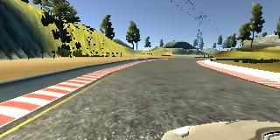
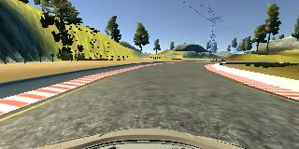
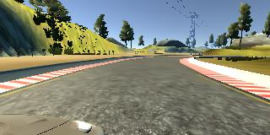
Camera views
Left Camera
Center Camera
Right Camera

Slide 8
Convolutional neural network model
Trained several CNN model for our self-driving car
Observed their robustness and accuracy
Tuned a lot of parameters and hyperparameters
The final one which contains 1 normalization layer, 5 convolution layer, 3 fully-connected layer and 1 drop-out layer having best model performance

Slide 9
evaluation
Human intervention gets involved when we think it is necessary
We count the autonomous time and human intervention time
The ratio of human intervention time and the autonomous time is used for evaluating the model performance: The less the ratio is, the better the model performance is

Slide 10

Model Design

Slide 11
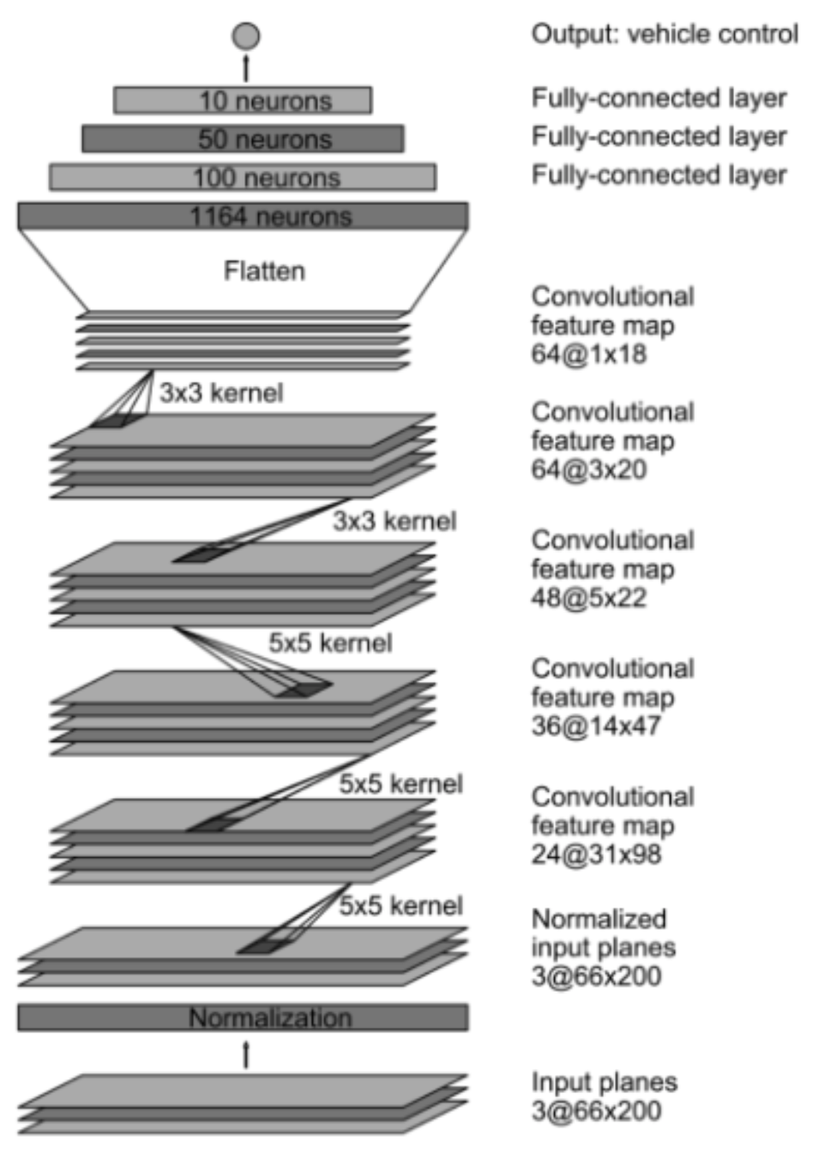
Model architecture
Notes:
We train the weights of our network to minimize the mean squared error between the steering command output by the network and the command of either the human driver, or the adjusted steering command for off-center and rotated images Our network architecture is shown in Figure. The network consists of 9 layers, including a normalization layer, 5 convolutional layers and 3 fully connected layers. The input image is split into several planes and passed to the network. The first layer of the network performs image normalization. The normalizer is hard-coded and is not adjusted in the learning process. Performing normalization in the network allows the normalization scheme to be altered with the network architecture and to be accelerated via GPU processing. The convolutional layers were designed to perform feature extraction and were chosen empirically through a series of experiments that varied layer configurations. We use strided convolutions in the first three convolutional layers with a 2×2 stride and a 5×5 kernel and a non-strided convolution with a 3×3 kernel size in the last two convolutional layers. We follow the five convolutional layers with three fully connected layers leading to an output control value which is the inverse turning radius. The fully connected layers are designed to function as a controller for steering, but we note that by training the system end-to-end, it is not possible to make a clean break between which parts of the network function primarily as feature extractor and which serve as controller.

Slide 12


Training and Results

Slide 13
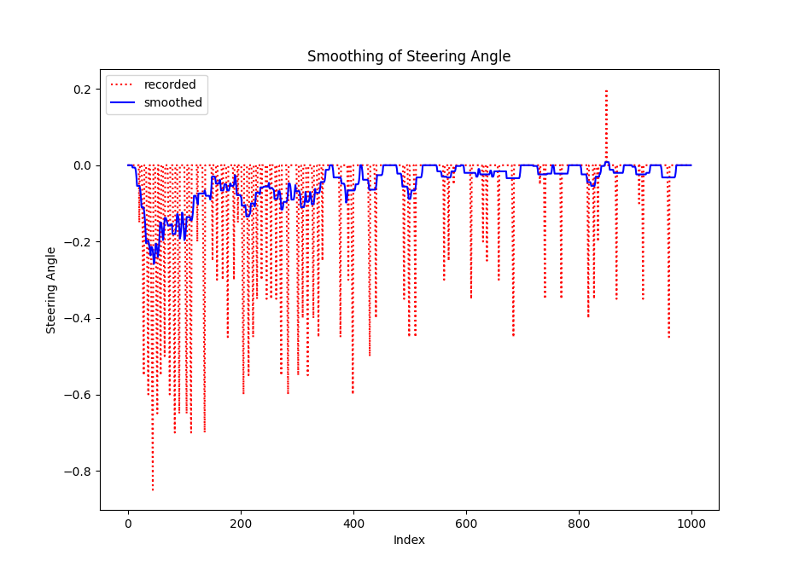
Training – steering angle smoothing
Due to the problem of the simulator, the recored steering angle can fluctuate a lot
Difficult to minimize loss function
Smoothing is used to solve the problem

Slide 14
Training – Overfitting
The model converges fast in the first few epochs, which is efficient for self-driving in the simulator.
After 20 epochs the models learns some wierd driving behavior
Add a dropout layer to overcome overfitting
Stop early to aviod learning unexpected behavior

Slide 15
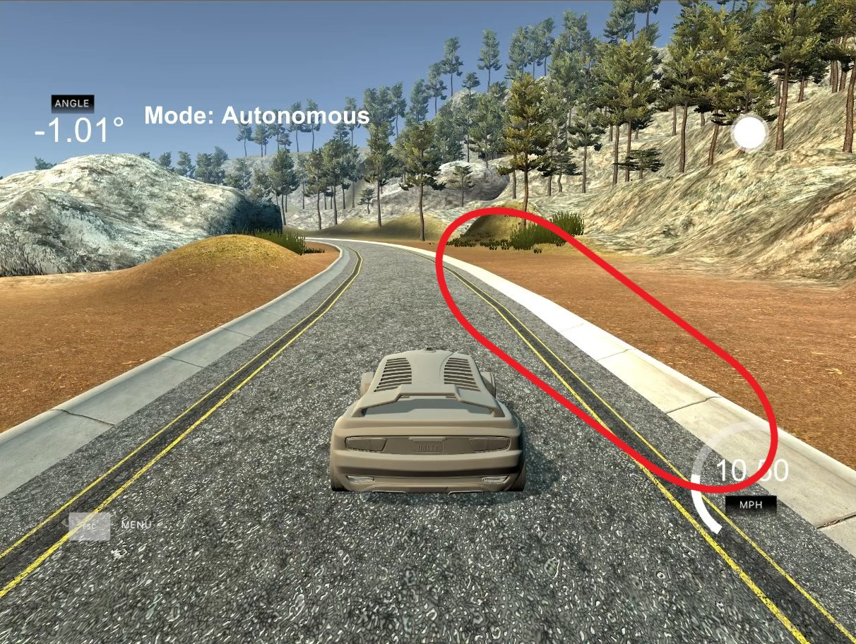
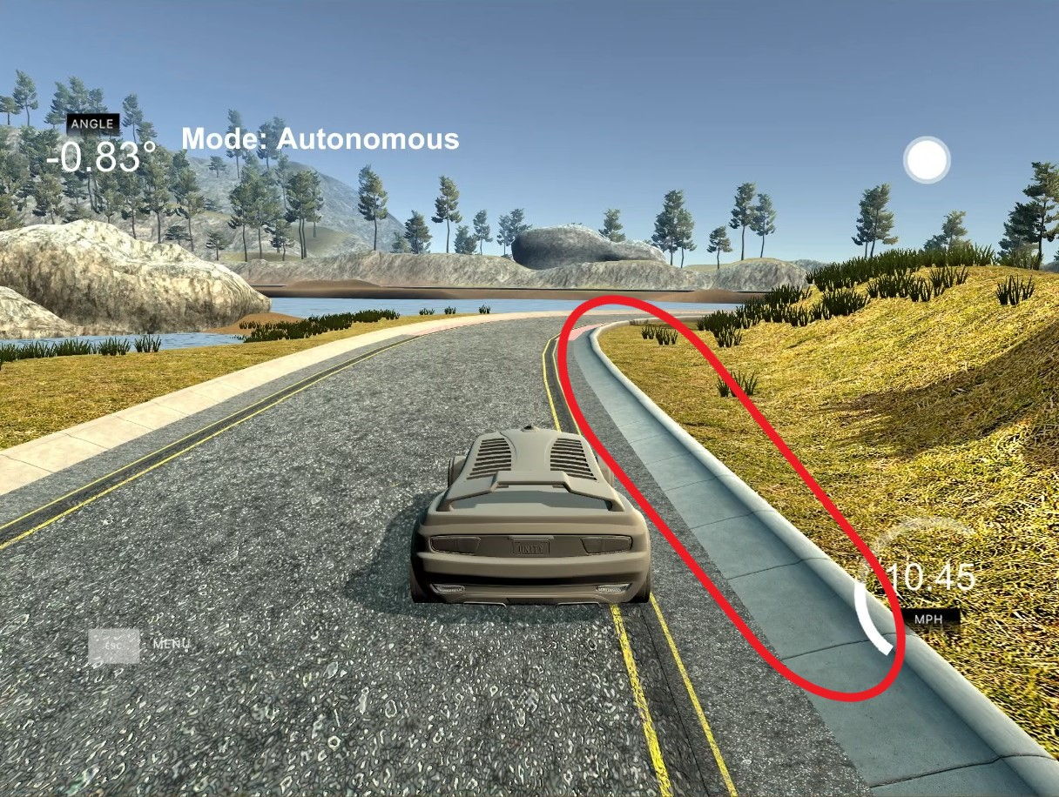
Data Shuffling
Illumimated Curbs
Curbs in Shadows

Slide 16
Data Shuffling
Without shuffling, the model learns the patterns only from the beginning of the route, yielding a bad performance in the other part of the road
Shuffling can make the model learn from the entire route, increasing robustness.

Slide 17
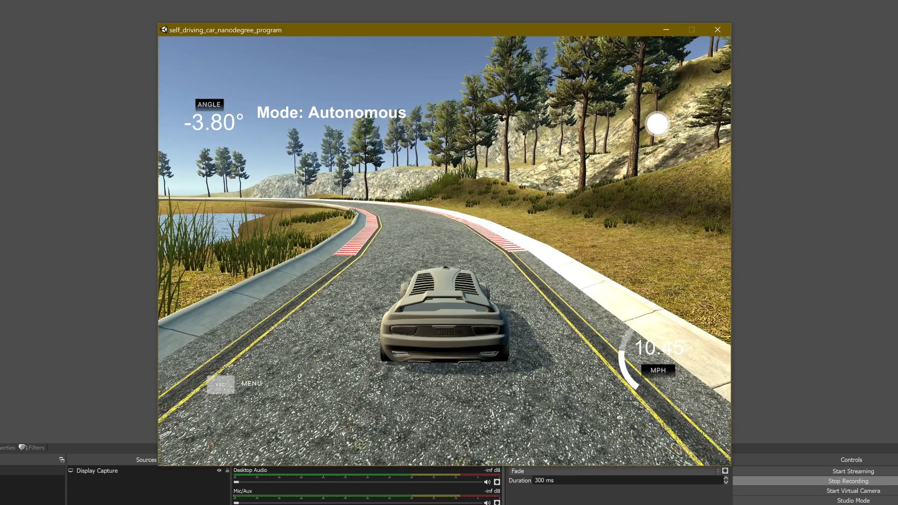
Results – Demo Video clip
Reached a human drive rate of only 0.709%
Most of the time, the car can position itself on the right course.
It can detect the curvature of the road and drive along.
The performance is not affected by lighting.
Full Demo Videos: Google Drive

Slide 18

Conclusions

Slide 19
Conclusion
Implemented a self-driving car Udacity self-driving simulator
Developed and tuned a CNN model
Implemented data transformation
SDC can deal with different road condition, degree of shadow and road marks
Proved that the possibility for CNN models to perform the tasks of self-driving

Slide 20
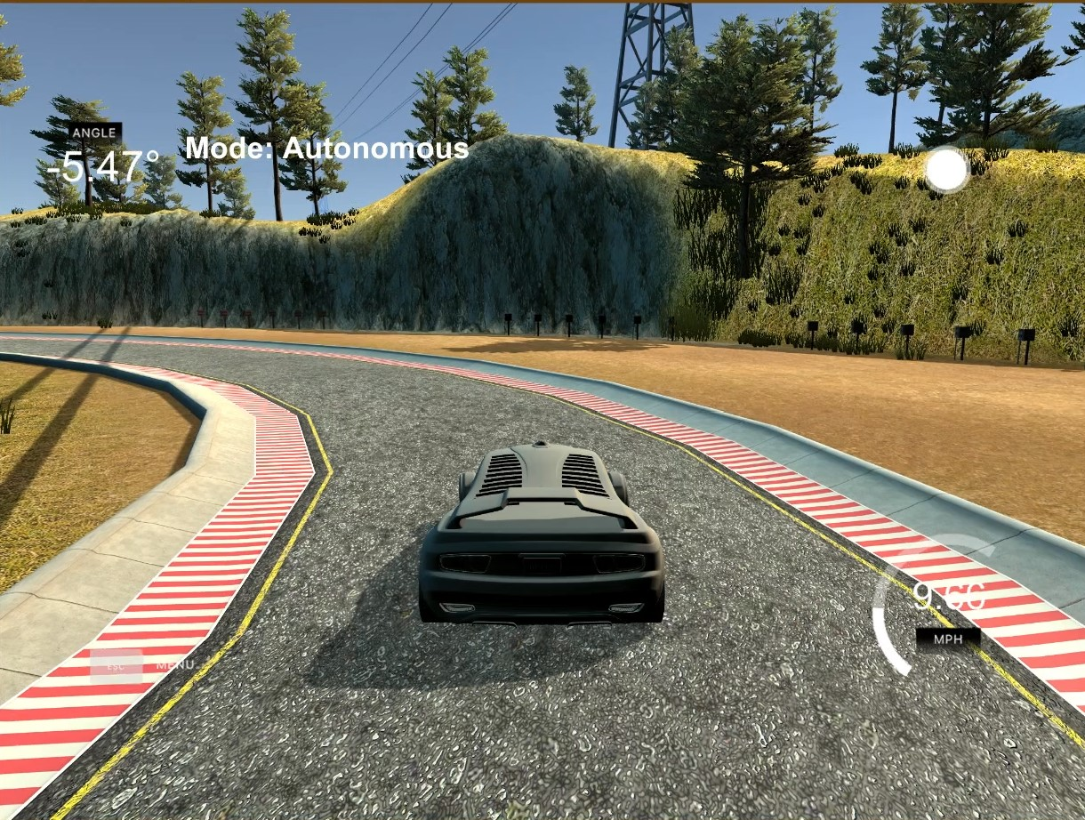
Thank you

